Slide 1
Data Privacy and Ethics
Introduction to Data Analytics day 12

Slide 2
Data Privacy and Ethics
In today's data-driven world, our personal information is constantly collected, analyzed, and used by various entities. While this offers benefits like personalized services and improved efficiency, it raises critical ethical concerns.

Slide 3
Key Ethical Considerations
Bias: Algorithms trained on biased data can perpetuate discriminatory practices in areas like loan approvals, hiring decisions, and targeted advertising. Discuss real-world examples and how to mitigate bias in data collection and analysis.
Transparency: Individuals have the right to know what data is collected about them, how it's used, and who has access to it. Explore data privacy regulations like GDPR and CCPA and discuss the importance of clear communication with users.
Security: Data breaches can expose sensitive information and harm individuals. Emphasize the importance of robust security measures and responsible data handling practices.

Slide 4
Key Principles of Data Privacy
Consent: Individuals should give informed consent for the collection, use, and sharing of their data.
Purpose Limitation: Data should only be collected and used for specific, legitimate purposes disclosed to the individual.
Data Minimization: Only collect and retain the minimum amount of data necessary for the intended purpose.
Transparency: Individuals should be informed about how their data is collected, used, and shared.
Security: Implement measures to protect data from unauthorized access, disclosure, or misuse.

Slide 5
Best Practices for Ensuring Data Privacy and Ethics:
Implement Privacy by Design: Incorporate privacy considerations into the design of data analytics systems and processes from the outset.
Data Anonymization and Pseudonymization: Remove or obfuscate personally identifiable information from datasets to protect individual privacy.
Regular Audits and Assessments: Conduct regular audits and assessments of data practices to ensure compliance with privacy regulations and ethical standards.

Slide 6
Case Study 1:
Facebook's Cambridge Analytica Scandal (2018)
In 2018, it was revealed that Cambridge Analytica, a political consulting firm, had improperly accessed personal data of millions of Facebook users without their informed consent. This data was allegedly used to create targeted political advertisements aimed at influencing the 2016 US presidential election.

Slide 7
Ethical Concerns
Privacy violation: Millions of users were unaware that their data was being collected and used for political purposes.
Informed consent: The data collection process lacked transparency and did not obtain explicit consent from users.
Bias and manipulation: Concerns arose about the potential for targeted advertising to exploit user biases and manipulate voting outcomes.

Slide 8
What happen next
Stronger data privacy regulations with clear user consent requirements.
Increased transparency from social media platforms about data collection and use.
Development of tools for users to manage their online privacy settings.
Education and awareness campaigns about responsible data sharing practices.

Slide 9
Case study 2
Clearview AI and Facial Recognition (2020)
Clearview AI, a company offering facial recognition technology, faced accusations of scraping billions of images from public websites and social media platforms without permission. This vast database was reportedly used by law enforcement agencies across the US, raising concerns about privacy, surveillance, and potential misuse

Slide 10
Ethical Concerns
Mass data collection: Clearview AI collected data without explicit consent, violating individuals' privacy expectations.
Surveillance and profiling: The widespread use of facial recognition by law enforcement raises concerns about mass surveillance and potential discrimination.
Accuracy and bias: Facial recognition technology has documented biases, leading to potential misidentification and wrongful accusations.

Slide 11
Data Governance
Data governance is the process of establishing policies, standards, roles, responsibilities, and controls for managing data across an organization or a system. Data governance helps us answer questions such as: What are the goals and objectives of using data? How do we define data quality and accuracy? Who has access to what data and for what purposes? How do we monitor and measure data performance? How do we handle data breaches or incidents?

Slide 12
Components of data Governance
Data Policies and Standards: Establishing clear policies and standards for data management is crucial. These policies define how data should be collected, stored, processed, accessed, and shared within the organization. Standards ensure consistency and interoperability across different systems and departments.
Data Stewardship: Data stewardship involves assigning responsibility for the oversight and management of specific data assets to individuals or teams within the organization. Data stewards are responsible for ensuring that data is accurate, consistent, and compliant with policies and regulations.
Data Quality Management: Data governance includes processes and tools for monitoring and improving data quality. This involves identifying and correcting errors, inconsistencies, and inaccuracies in data to ensure its reliability and usefulness for decision-making and analysis.

Slide 13
Components of data Governance
4. Data Security and Privacy: Protecting sensitive data from unauthorized access, disclosure, or loss is a critical aspect of data governance. This includes implementing access controls, encryption, and other security measures to safeguard data assets. Additionally, data governance ensures compliance with data privacy regulations, such as GDPR or CCPA, by defining procedures for obtaining consent, anonymizing data, and responding to data breaches.
5.Data Lifecycle Management: Data governance encompasses managing the entire lifecycle of data, from creation and capture to archival or disposal. This involves establishing policies and procedures for data retention, archival, and deletion to ensure compliance with regulatory requirements and minimize risks associated with storing unnecessary data.
6. Data Compliance and Risk Management: Data governance helps organizations mitigate risks associated with data management and ensure compliance with regulatory requirements, industry standards, and internal policies. This includes conducting risk assessments, audits, and compliance reviews to identify and address potential vulnerabilities and ensure adherence to data protection laws and regulations.

Slide 14
Applications
Healthcare: Ensuring accurate medical records for patient safety and effective treatment.
Finance: Protecting sensitive financial data and complying with regulations.
Marketing: Delivering personalized experiences based on customer data.
Data governance is a continuous process, not a one-time fix.
It's about collaboration, involving all stakeholders in the organization.
Everyone plays a role in ensuring responsible data management.

Slide 15
Ethics and governance work
Data ownership: Data ethics emphasizes individuals' ownership of their personal information, while data governance outlines procedures for obtaining consent before collecting or utilizing such data.
Data quality: Data ethics stresses the importance of accurate, complete, relevant, timely, and consistent data, while data governance establishes methods for assessing and enhancing data quality.
Data security: Data ethics demands protection of data from unauthorized access or misuse, while data governance implements controls to secure data storage and transmission.
Data transparency: Data ethics advocates for clear, accountable, and auditable data practices, while data governance establishes mechanisms for documenting, reporting, and reviewing data activities.

Slide 16
Data Protection Act, Kenya (2019)
Protect the right to privacy guaranteed by the Kenyan Constitution.
Establish the Office of the Data Protection Commissioner (ODPC) to regulate data processing.
Define rights of data subjects (individuals whose data is processed) and obligations of data controllers (those who determine how data is processed) and data processors (those who process data on behalf of controllers).

Slide 17
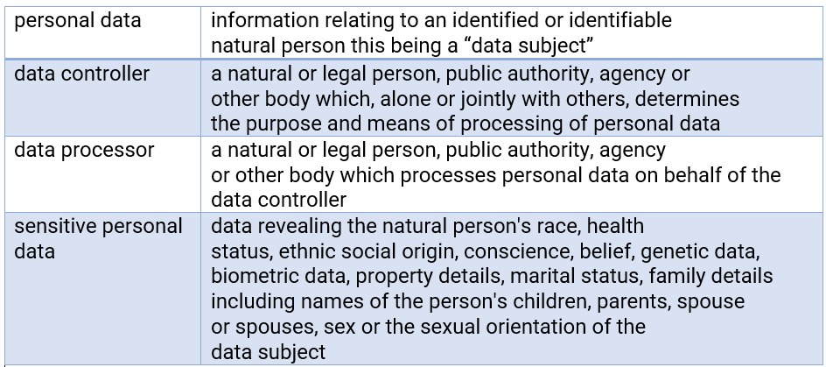
PROVISIONS OF THE ACT & APPLICATION

Slide 18
Core Principles of Data Processing
Lawfulness: Data must be processed lawfully and fairly.
Transparency: Data subjects must be informed about how their data is processed.
Purpose limitation: Data can only be processed for specified, explicit, and legitimate purposes.
Data minimization: Only the minimum necessary data can be collected and processed.
Accuracy: Data must be accurate and kept up-to-date.
Storage limitation: Data can only be stored for as long as necessary.
Integrity and confidentiality: Data must be protected against unauthorized or unlawful processing.
Accountability: Data controllers are responsible for ensuring compliance with the Act.

Slide 19
Rights of Data Subjects
Right to access their personal data.
Right to rectification of inaccurate data.
Right to erasure of data under certain conditions.
Right to restrict processing of data.
Right to data portability.
Right to object to automated processing, including profiling.

Slide 20
Obligations of Data Controllers
Implement appropriate technical and organizational measures to protect personal data.
Conduct data protection impact assessments when necessary.
Report data breaches to the ODPC and affected individuals.
Appoint a data protection officer (DPO) in certain cases.

Slide 21
Review Exercises
See attached

